Slide 1





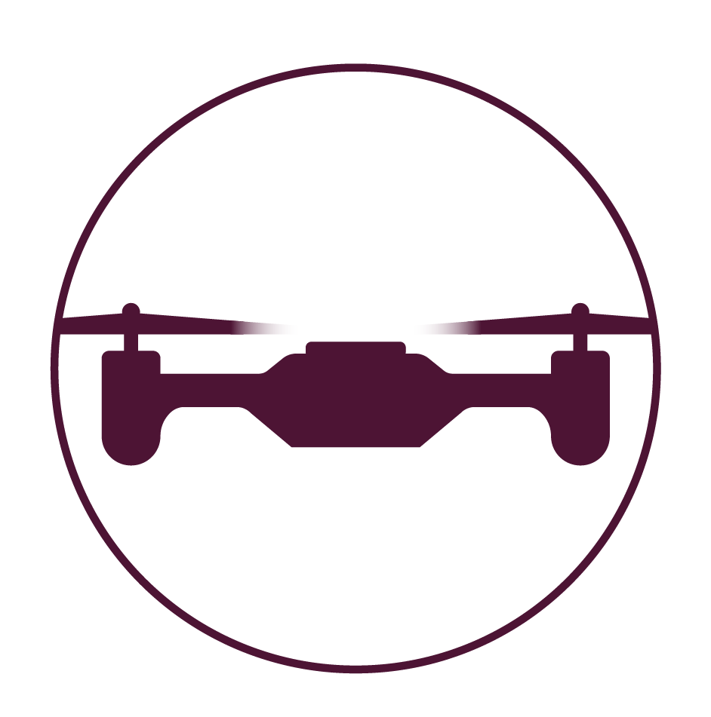
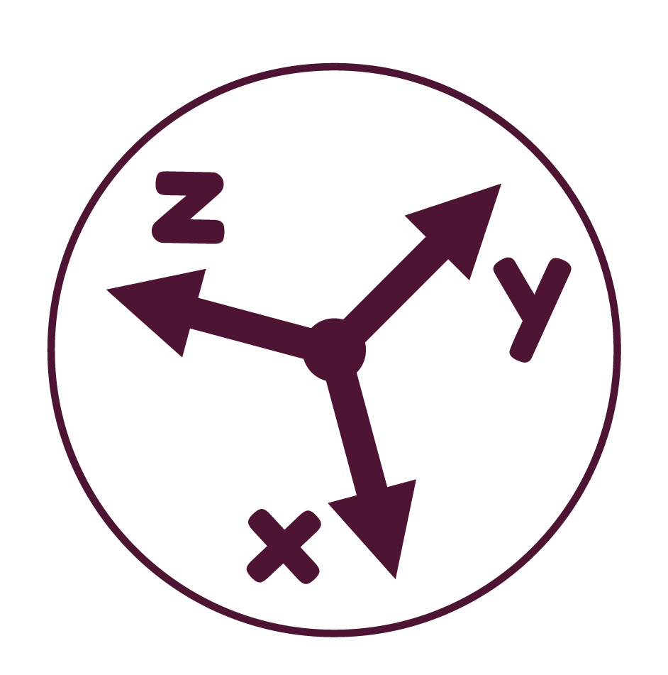
DIP Lab 2
Introduction to OpenCV
KalEEM ullah
School of electrical engineering and computer science
National University of Sciences and Technology

Slide 2
Overview
This lab will be centered on the following:
Understand the image data as an array of pixels
Load and Save images
Display images in different windows
Access and modify pixels in images
Access and modify regions in images
Place lines, rectangles, circles and text in images
Resize images at various scales
Rotate images at various angles

Slide 3
OpenCV
OpenCV is an imaging library used widely for computer vision tasks such as feature extraction, stereovision, image stitching, pose estimation and many more
Computer vision is the field that involves getting information from image data
OpenCV is available in Python, C++ and MatLab
To use OpenCV in Python, we import the library:
import cv2

Slide 4
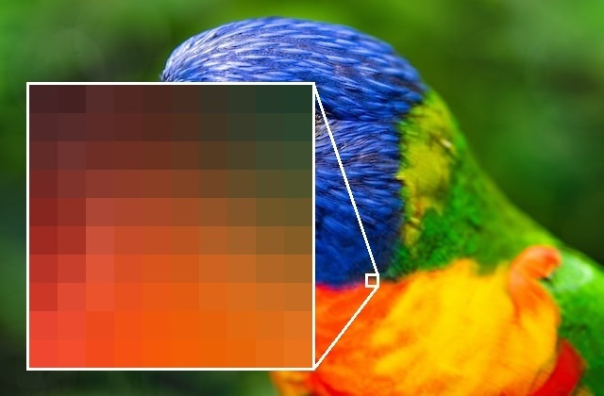
Images
An image is an array of unit squares called “pixels”
Pixels
Each pixel has a location (x,y) in the image array
Each pixel has some color values (intensity level)

Slide 5
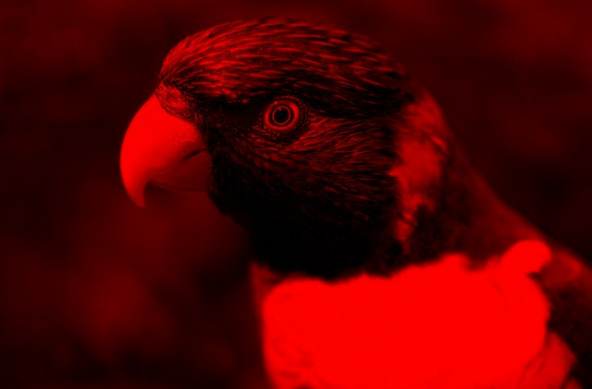
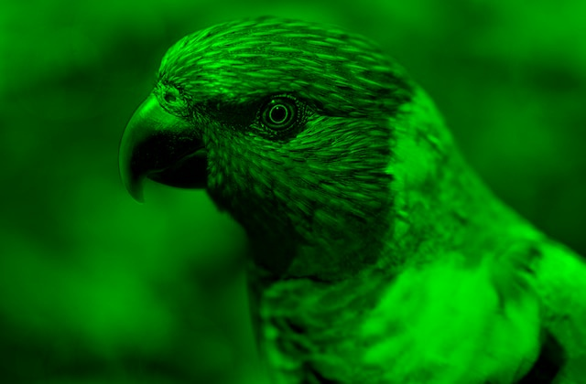
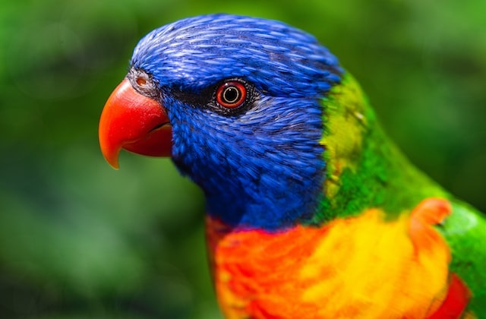
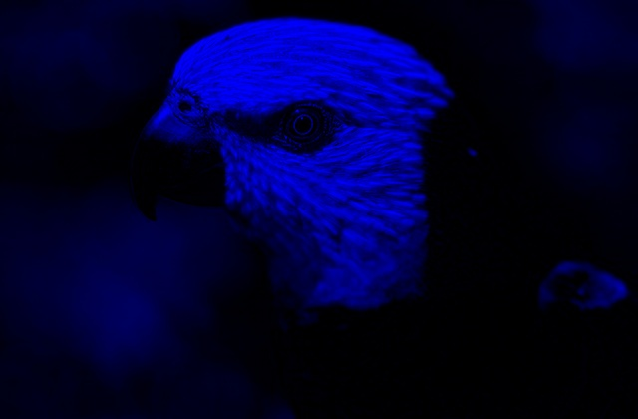
Images
A colored image has 3 channels, i.e. there are 3 color values in every pixel:
Blue (channel 0)
Green (channel 1)
Red (channel 2)
By default, OpenCV stores channels as BGR (not RGB)

Slide 6
Images
An image is essentially a 3-D array defined by its height (y), width (x) and number of channels (n)
Notice that the y-axis points
downwards in the pixel frame
n
x
y

Slide 7
Load Images
To load an image, we use the imread function:
The above function will load the image file and place it in imgA.
The imgA is like a variable that stores an image and we can use it in our program to reference the image
(The second argument in the imread function chooses the color mode;
0 is for grayscale, 1 is for colored and -1 is for alpha-channel inclusive)
imgA = cv2.imread(“my_image.jpg”, 1)

Slide 8
Load Images
If the image is in the same directory as the script file, the image filename is directly used:
If the image is in a different directory then the entire path to the image must be provided:
imgA = cv2.imread(“p3at.jpg”, 1)
imgB = cv2.imread('D://docs/Robot Pics/turtlebot.jpg', 1)

Slide 9
Display Images
Once the image is loaded, it can be displayed using the imshow function:
The first argument is the window name. This name appears at the top of the window which shows the image.
The second argument is the image object that is to be displayed
cv2.imshow('image1',imgA)

Slide 10
Display Images
Once the image is loaded, it can be displayed using the imshow function:
When the imshow function is used, the image appears only for a very small time before it closes. To avoid this, the waitKey function is used to hold the image.
The argument for the waitkey function specifies the time (in milliseconds) to hold the image. If the argument is 0, then the image is held for infinite time until the user presses a key.
cv2.imshow('image1',imgA)
cv2.waitKey(0)

Slide 11
Display Images
The following code will display two images
To ensure all windows are closed, the destroyAllWIndows function is used.
(Another function called destroyWindow(‘window_name’) can be used to close a specific window)
cv2.imshow('image1',imgA)
cv2.imshow('image1',imgB)
cv2.waitKey(0)
cv2.destroyAllWindows()

Slide 12
Save Images
To save an image on disk, the imwrite function is used:
The first argument is the name of the image file to be saved
The second argument is the image object that we are saving
cv2.imwrite(‘myImageRotated.jpg',imgA)

Slide 13
Basic Operations
Consider the image of size 620 x 420
The x-axis goes from 0 to 619
The y-axis goes from 0 to 419
(The channels go from 0 to 2)
0
619
0
x
419
y

Slide 14
Basic Operations
To get the BGR values of a specific pixel at location (px, py), we use:
img = cv2.imread(‘bird.jpg', 1)
val = img[py, px, :]
0
px
619
0
x
The first index (py) is the row of the array. It corresponds to the y-axis
The second index (px) is the column of the array. It corresponds to the x-axis
The third index (:) is the channel
py
(px,py)
419
y

Slide 15
Basic Operations
To get the BGR values at a number of pixels:
img = cv2.imread(‘bird.jpg', 1)
print(img[380,62,:]) print(img[150,150,:]) print(img[48,350,:]) print(img[372,588,:])
0
619
0
x
(350,48)
(150,150)
Output:
[27 59 42]
[ 2 54 251]
[251 151 127]
[ 0 102 184]
(62,380)
(588,372)
419
y

Slide 16
Basic Operations
To get the BGR values at location (0,0) pixel:
img = cv2.imread(‘bird.jpg', 1)
print(img[0,0,:]) # BGR
print(img[0,0,0]) # B
print(img[0,0,1]) # G
print(img[0,0,2]) # R
0
619
0
x
(0,0)
Output:
[22 143 63]
22
143
63
419
y

Slide 17
Basic Operations
The shape attribute is used to get the dimensions of the array:
img = cv2.imread(‘bird.jpg', 1)
rows = img.shape[0]
cols = img.shape[1]
print(img.shape)
print(rows)
print(cols)
0
619
0
x
Output:
(420, 620, 3)
420
620
419
y

Slide 18
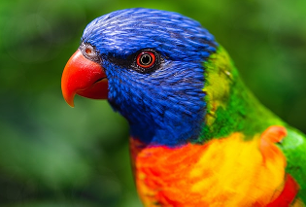
Basic Operations
The following code will load an image and display its color channels
img = cv2.imread(‘bird.jpg', 1)
imgB = img[:,:,0]
imgG = img[:,:,1]
imgR = img[:,:,2]
cv2.imshow('Original',img)
cv2.imshow('Blue',imgB)
cv2.imshow('Green',imgG)
cv2.imshow('Red',imgR)
cv2.waitKey(0)
cv2.destroyAllWindows()

Slide 19
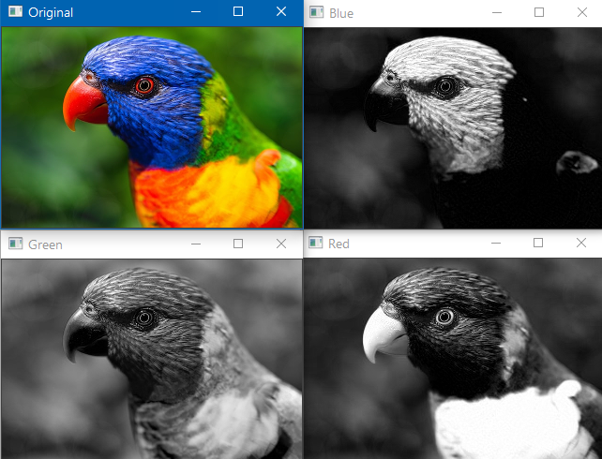
Basic Operations
The results are shown.
The more white color indicates large values of the channel color
Note that the color channels are ordered as BGR (instead of RGB) in OpenCV:
imgB = img[:,:,0]
imgG = img[:,:,1]
imgR = img[:,:,2]

Slide 20
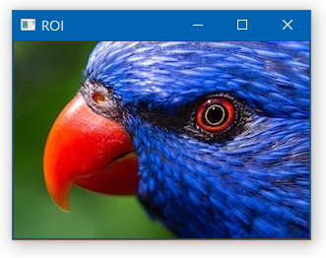
Cropping Images
Cropping a region of image (ROI) is similar to accessing pixels
A range of pixel values can be taken using a slice operation (:)
img = cv2.imread(‘bird.jpg', 1)
img_crop = img[50:250,100:400]
cv2.imshow(‘ROI', img_crop)
cv2.waitKey(0)
100
400
619
x
50
250
419
y

Slide 21
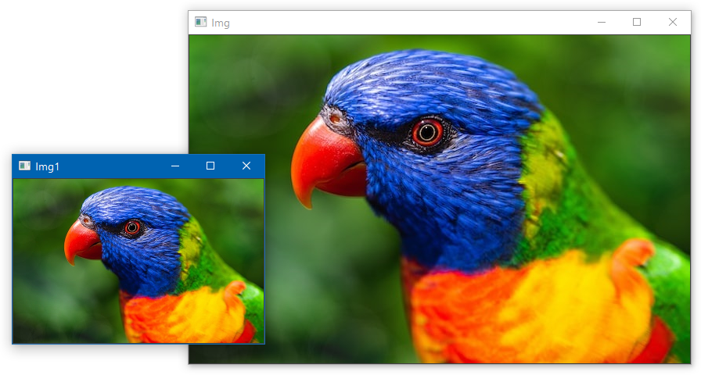
Scaling Images
The resize function is used to change the image size
fx and fy are the scaling
factors
Scaling factor of 0.5 means
half of original length
imgResize = cv2.resize(img,None,fx=0.5, fy=0.5, interpolation = cv2.INTER_CUBIC)
cv2.imshow('Img', img)
cv2.imshow('Img1', img_reSize)

Slide 22
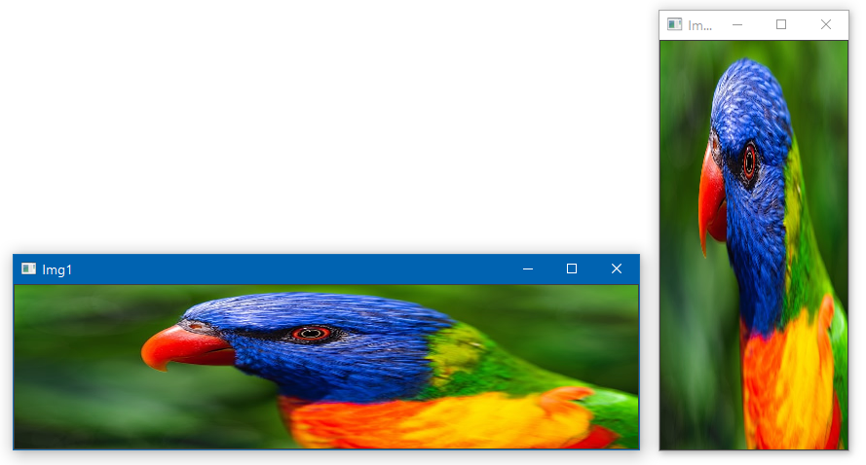
Scaling Images
If the scaling factors fx and fy are not equal, the image gets stretched
img_resized1 = cv2.resize(img,None,fx=1,
fy=0.4, interpolation = cv2.INTER_CUBIC)
img_resized2 = cv2.resize(img,None,fx=0.3,
fy=1, interpolation = cv2.INTER_CUBIC)

Slide 23
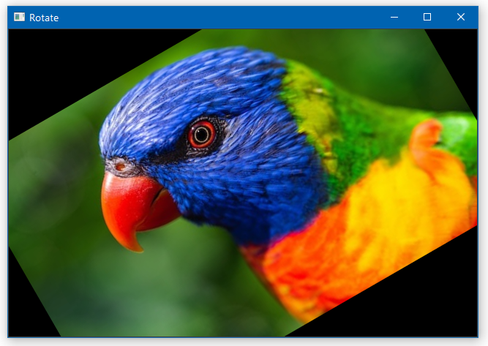
Rotating Images
Rotated at 30 degrees
To rotate the image, 2 functions are used:
getRotationMatrix2D to compute the transformation matrix
warpAffine to apply the rotation transformation to the image matrix
img = cv2.imread(‘bird.jpg', 1)
rows = img.shape[0]
cols = img.shape[1]
M = cv2.getRotationMatrix2D((cols/2,rows/2),30, 1)
rot = cv2.warpAffine(img,M,(cols,rows))
cv2.imshow(‘Rotate', rot)

Slide 24
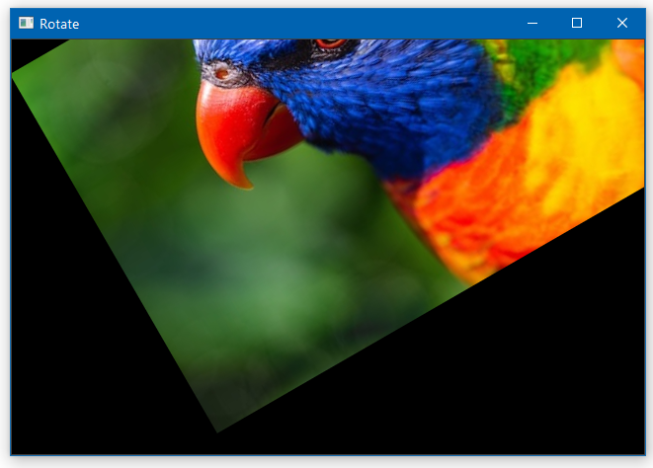
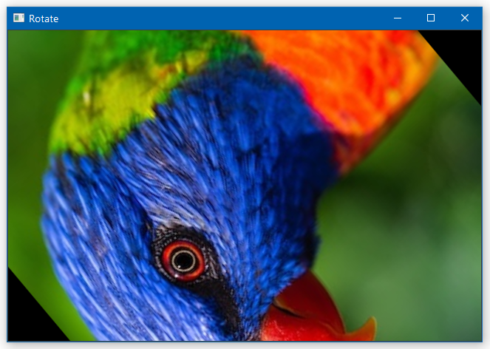
Rotating Images
The getRotationMatrix2D takes the following inputs:
Center of rotation (cx, cy)
Angle of rotation A
Scale factor k
M = cv2.getRotationMatrix2D((cx, cy), A, k)

Slide 25
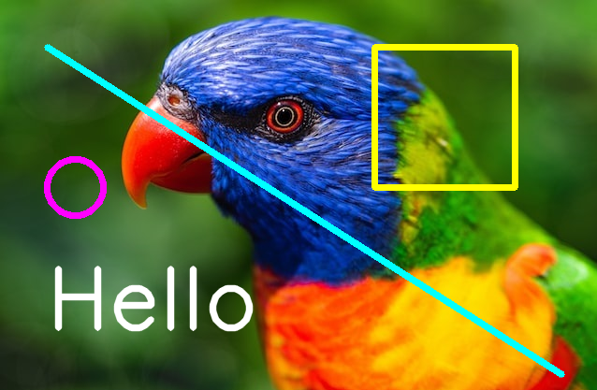
Placing Shapes
Various shapes can be placed in the image:
(x1,y1) start point
(x2,y2) end point
(xc,yc) center point
(B,G,R) color values from 0 to 255
thickness line thickness (-1 for solid color)
Text can also be placed in the image:
img1 = cv2.line(img,(x1,y1),(x2,y2),(B,G,R),t)
img2 = cv2.rectangle(img,(x1,y1),(x2,y2),(B,G,R),t)
img3 = cv2.circle(img,(xc,yc), radius, (B,G,R), t)
cv2.putText(img,'Hello', (x,y), cv2.FONT_HERSHEY_SIMPLEX, size, (B,G,R), thickness, cv2.LINE_AA)

Slide 26
Placing Shapes
The following example places some shapes and text in the image
img = cv2.line(img,(50,50),(600,400),(255,255,0),5)
img = cv2.rectangle(img,(400,50),(550,200),(0,255,255),5)
img = cv2.circle(img,(80,200), 30, (255,0,255), 5)
font = cv2.FONT_HERSHEY_SIMPLEX
cv2.putText(img,'Hello',
(50,350), font, 3,
(255,255,255), 5, cv2.LINE_AA)
cv2.imshow(‘Shapes', img)

Slide 27
Lab Tasks
Download the manual from LMS
Perform the Lab Tasks as given in the manual and submit it on LMS
Remember to execute scripts with the terminal

